Slide 1

FP 16
Systematic Study of Background Subtraction Techniques for EELS
Veerendra C Angadi

Slide 2
Motivation
EELS is a very important tool for elemental analysis of materials science
Net core loss = spectrum – background
extrapolating the background in the presence of preceding edges is difficult
Background fitting in the presence of ELNES, EXELFS etc.
Explore extrapolation from other regions such as post-ionization edge
Explore extrapolations which are combination of fits in different region

Slide 3
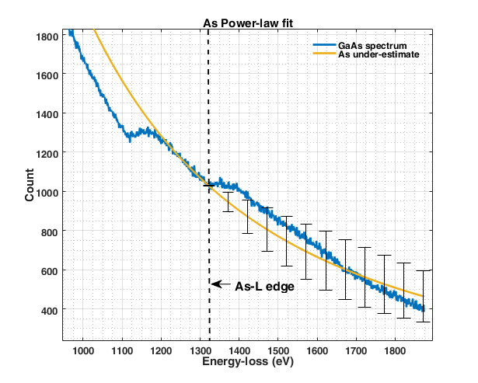
Pre-edge region:
Background crossing the spectrum - unphysical
As-L edge can still be quantified by integrating only the positive core-loss region.
This yields an under-estimate
The Ga-L edge is straight forward as the it has very large pre-edge region.
Highly associated with large systematic errors for large integration range.
Systematic errors are difficult to identify by regression and quantification.

Slide 4
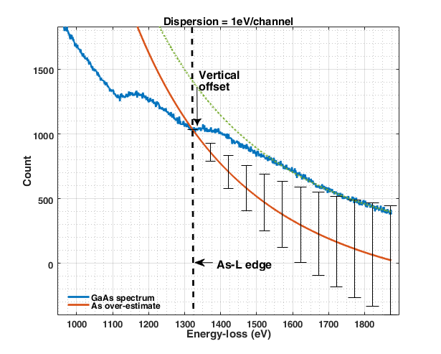
Post-edge region:
Extrapolate from end of the spectrum and offset vertically to cross through the edge onset
Over-estimate of the core-loss edge intensity
Poissonian statistical error bars are very large
Highly associated with statistical errors and are difficult to identify by regression and quantification.
For Ga-L edge, As-L edge is subtracted to provide larger post-edge region for extrapolation

Slide 5
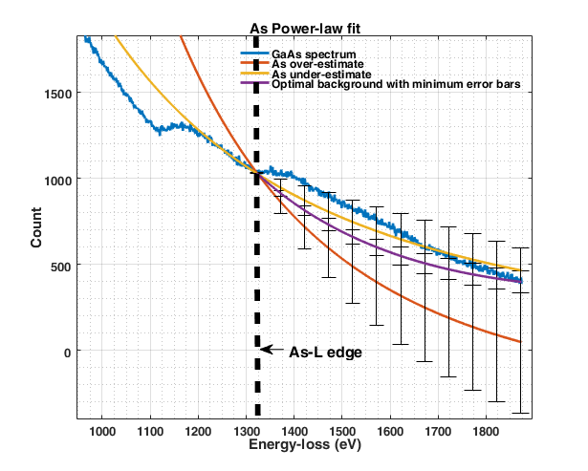
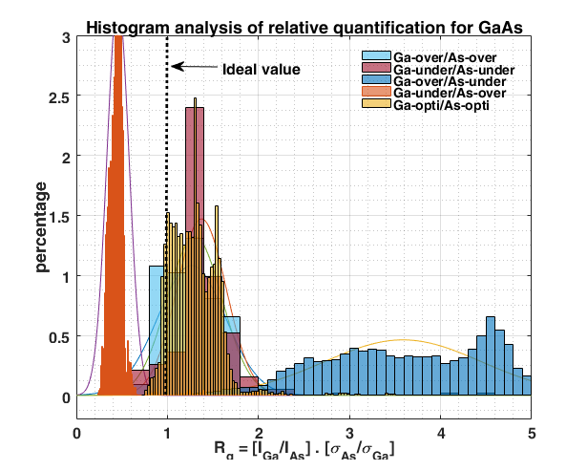
Optimal fit:
Fits in pre-edge and post-edge regions provide under-and over-estimate of the core-loss edges
Only backgrounds which are physically meaningful are retained
Yields positive core-loss
Have smaller error bars
More discussions in poster
P16

